Slide 1
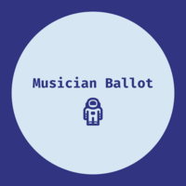
Musician Ballot
#Music-On-The-BlockChain

Slide 2
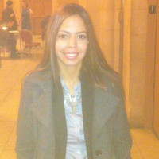


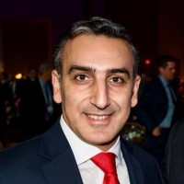
The Team
Roland Ferrao
Armen Arsenyan
Jennifer Rionda
Expert engineer with newly expanded skill-set in blockchain applications
Advanced architect of smart contracts built on blockchain applications
Professional storyteller, amateur user experience designer and blockchain engineer

Slide 3
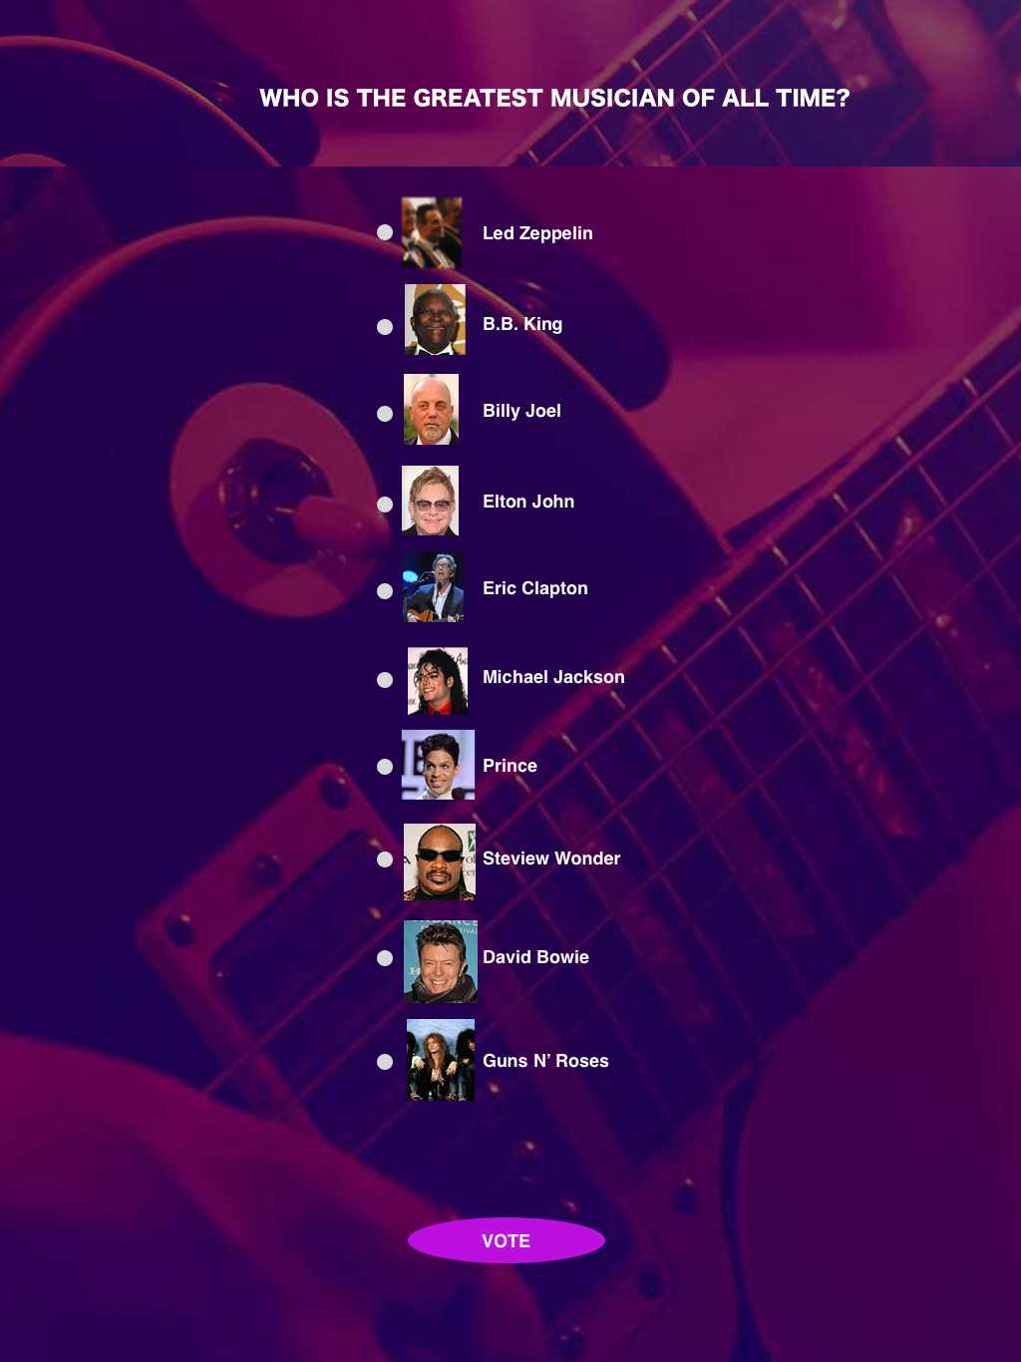
The MB App
Is a decentralized application built on the Ethereum blockchain that allows users to vote on their favorite musician from a predefined list

Slide 4
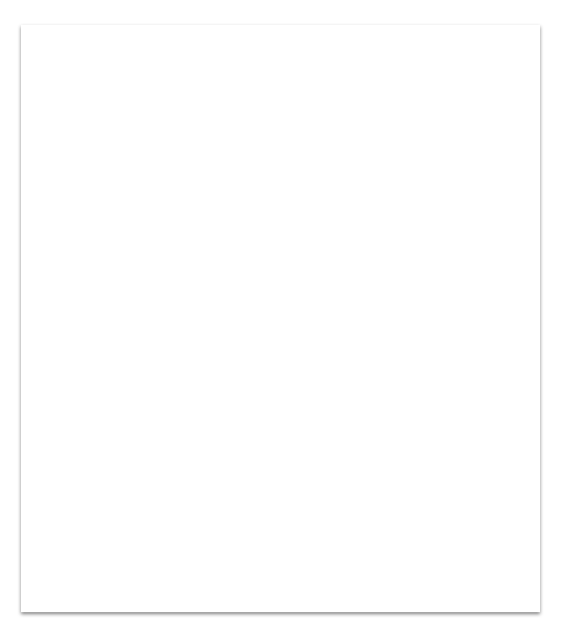
The voting transaction
Is registered on the blockchain using the Rinkeby testnet network and Metamask wallet
Java/CSS/HTML (UI)
MetaMask (Wallet
Ethereum (Blockchain)
Truffle (Dev Environment)
Solidity (Contract Language)
Rinkeby (Network)

Slide 5
Key benefits
Secure method to capture votes with broad application (e.g., electoral voting)
Connected to a simple and intuitive user interface

Slide 6
Challenges
Resources engineered their solution on Solidity 5.0; differences are material
Learning curve for the Truffle Suite, which allows you to develop locally, over Remix
R

Slide 7
Now let’s test the app!

